Slide 1
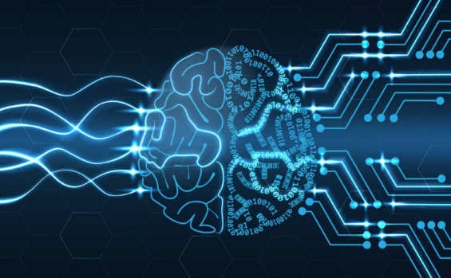
Welcome To The Presentation
Name | ID
Tasmia Tasmin | 2014-2-60-025
Md. Tanvir Aunjum | 2014-1-60-030
Kevin Stephen Biswas | 2014-2-60-091

Slide 2
Topic
Comparison between Decision Tree and SVM by using same dataset and application of APriori algorithm for finding "Interesting Association Rules"

Slide 3
Dataset:Glass Identification
It contains 10 Attribute(including Id)
The response is glass type(discrete 7 values):
1 For Building Windows float
2 For Building Windows Non-float
3 For Vehicle Windows Float
4 For Vehicle Windows Non-float (none in this database)
5 For Containers
6 For Tableware
7 For Headlamps

Slide 4
Attribute Information
RI: refractive index
Na: Sodium (unit measurement: weight percent in corresponding oxide, as are attributes 4-10)
Mg: Magnesium
Al: Aluminum
Si: Silicon
K: Potassium
Ca: Calcium
Ba: Barium
Fe: Iron
Type of glass: (class attribute)

Slide 5
Other DataSets:
Breast-Cancer
Car
Credit-A
Ecoli
hepatitis

Slide 6
Algorithm C4.5 Comparison:
20%

